Slide 1
Is Recycling Wasted? The Circular Economy and the Material Rebound Effect
UCPH, 30 June 2025
Rasmus K. S. Berg,
Peter K. Kruse-Andersen, and Thor D. Noe

Slide 2
Introduction
Linear economy
Natural resources
Production
Consumption
Waste

Slide 3


Introduction
Linear economy
Natural resources
Externalities
Production
Consumption
Externalities
Waste

Slide 4
Introduction
Circular economy
Natural resources
Production
Consumption
Recycling
Waste

Slide 5
Introduction
Circular economy
Remanufacturing
Natural resources
Production
Waste as a resource
Consumption
Repair og reuse
Recycling
Waste

Slide 6
Introduction
Keen political focus on the supply of raw materials:
Sustainability agenda.
National security agenda.
Key question: How effective do circular economy policies reduce the dependence of primary raw materials?
We develop a new macroeconomic model designed to answer this question.
We find that circular economy policies may backfire, i.e. they may increase primary material use.
Our focus is the Material Rebound Effect which measures the degree to which the “expected” saving of primary materials are offset by behavioral responses.

Slide 7




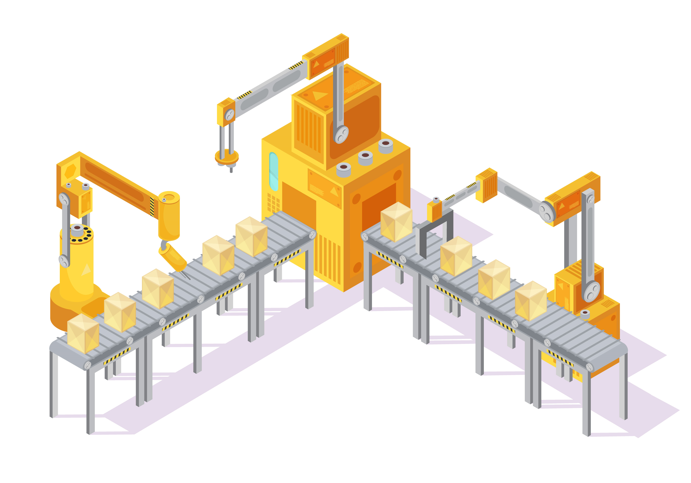

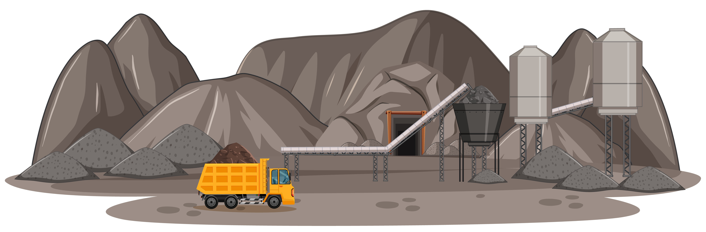
Introduction
A typical macroeconomic model
Production sectors
Labour and capital inputs
Consumers

Slide 8
Introduction
A typical macroeconomic model
Production sectors
Labour and capital inputs
Consumers

Slide 9
Introduction
A typical macroeconomic model
Production sectors
Labour and capital inputs
Input
Consumers

Slide 10
Introduction
A typical macroeconomic model
Production sectors
Labour and capital inputs
Input
Output
Consumers

Slide 11
Introduction
A typical macroeconomic model
Production sectors
Labour and capital inputs
Input
Output
Consumers
No waste
Virgin natural resources cannot be substituted by recycled materials

Slide 12










Introduction
A typical macroeconomic model
$$Y$$
CES aggregate
Leontief assumption
$$KL$$
$$Z$$
$$L$$
$$K$$
$$X_{1}$$
$$…$$
$$X_{i}$$
$$…$$
$$X_{I}$$
No substitution possibilities between recycled materials and virgin materials

Slide 13



Introduction
Our framework
Production sectors
Labour and capital inputs
Consumers
Output
Input

Slide 14
















Introduction
Our framework – A simplified picture
$$Y^{regular}$$
$$Y^{Material}$$
$$Y$$
$$KL$$
$$Z$$
$$L$$
$$K$$
$$X$$
$$Z^{M}$$
$$X_{1}$$
$$…$$
$$X_{i}$$
$$…$$
$$X_{I}$$
$$Z^{V}$$
$$Z^{R}$$
Other intermediate goods
(measured in value terms)
Virgin and recycled materials
(measured in mass units)

Slide 15



Introduction
Our framework – A simplified picture
$$W^{recycled}$$
Valuable waste
$$Y^{regular}$$
$$Y^{Material}$$
$$Y$$
$$W$$
Waste
Transferred to waste management sector
$$KL$$
$$Z$$
$$W^{treatment}$$
$$L$$
$$K$$
$$X$$
$$Z^{M}$$
$$X_{1}$$
$$…$$
$$X_{i}$$
$$…$$
$$X_{I}$$
$$Z^{V}$$
$$Z^{R}$$
Other intermediate goods
(measured in value terms)
Virgin and recycled materials
(measured in mass units)

Slide 16
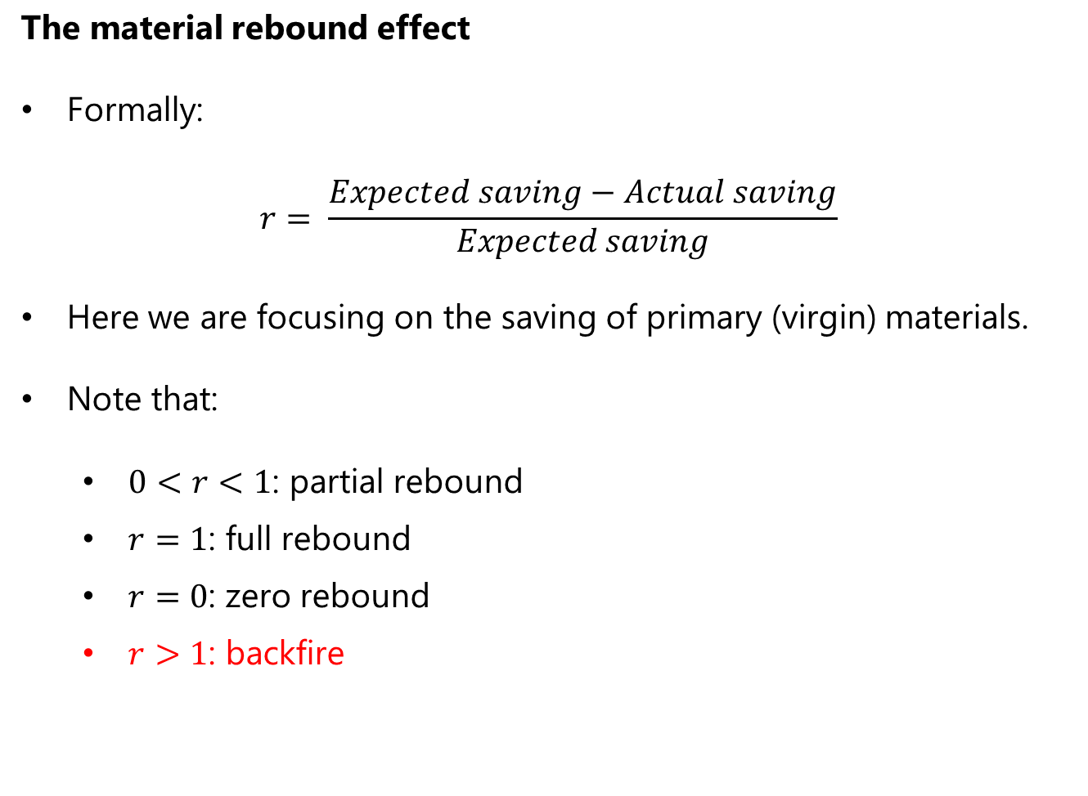
Introduction
The material rebound effect
Formally:
$$r= \frac{Expected saving−Actual saving}{Expected saving}$$
Here we are focusing on the saving of primary (virgin) materials.
Note that:
$0<r<1$: partial rebound
$r=1$: full rebound
$r=0$: zero rebound
$r>1$: backfire

Slide 17
Introduction
The material rebound effect
Production
Virgin natural resource input
Recycled materials (positive value)
Recycled materials
Waste
(negative value)

Slide 18
Introduction
The material rebound effect
Production
Virgin natural resource input
Recycled materials (positive value)
Recycled materials
Policy or
technological shock
Waste
(negative value)

Slide 19
Introduction
The material rebound effect
Production
Virgin natural resource input
Recycled materials (positive value)
Recycled materials
Policy or
technological shock
Waste
(negative value)
Supply of recycled materials
Demand for virgin materials

Slide 20
Introduction
The material rebound effect
Production
Virgin natural resource input
Recycled materials (positive value)
Recycled materials
Policy or
technological shock
Waste
(negative value)
Price of production
Demand for materials
Demand for virgin materials
Supply of recycled materials
Demand for virgin materials

Slide 21
Literature
Circular Economy Rebound in environmental engineering (Castro et al., 2022) and industrial ecology (Zink and Geyer, 2017). We contribute with a macroeconomic perspective.
Early evidence of backfire in simple economic models (Sauders, 2014). We contribute with a multi-sector model featuring recycling.
CGE models incorporates physical flows into CGE models (Sjöström and Östblom, 2010; Skelton et al., 2020; Yerushalmi and Saha, 2025). We contribute with a model featuring recycling.
Theoretical studies (Sørensen, 2018; Smulders and Zhou, 2021; Egger and Keuschnigg, 2024). We contribute with theory related to the rebound effect as well as numerical results.

Slide 22
Literature
Key contributions
Analysis of material rebound effect in a tractable macroeconomic model.
Develop a numerical macroeconomic model calibrated on national accounts and material flow accounts data that enables analysis of circular economy policies.
Method to keep track of both the mass and value of key materials.
Development of elaborate recycling sector.
Distinguish between virgin, recycled, and waste materials.
Provide estimates of material rebound effect.

Slide 23
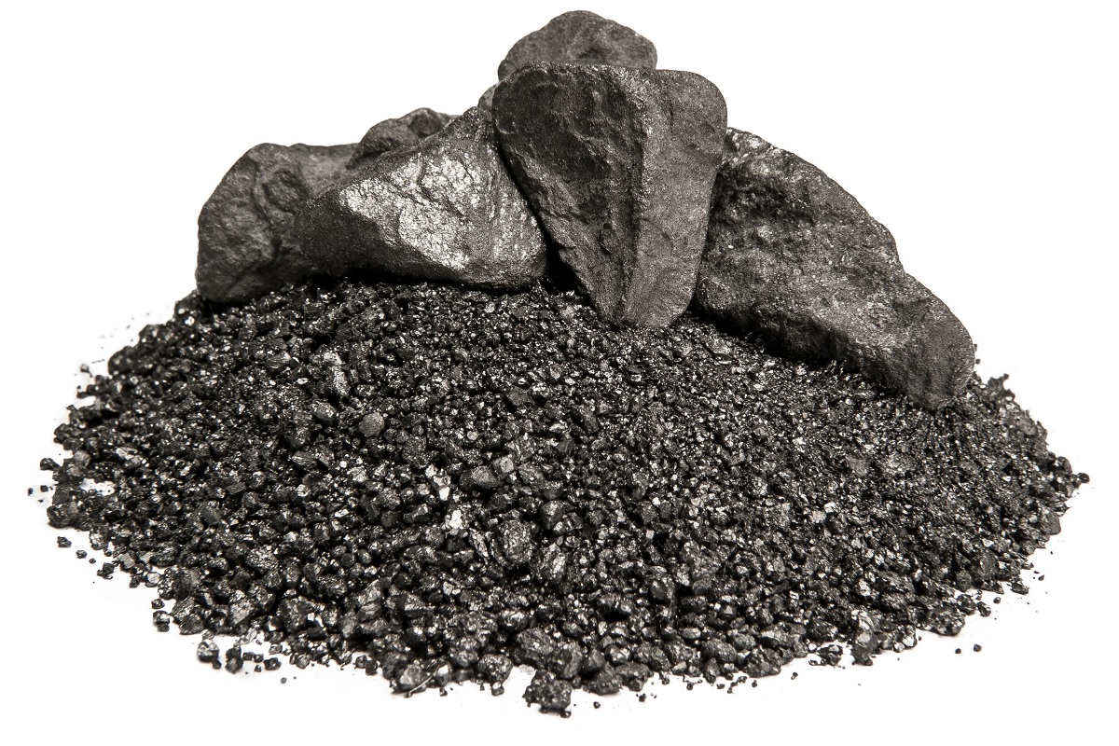
Small macro model
Overview
Production sectors
Labour and natural resources
Consumers
Virgin materials

Slide 24
Small macro model
Overview
Production sectors
Labour and natural resources
Consumers
Virgin materials
Recycled materials

Slide 25
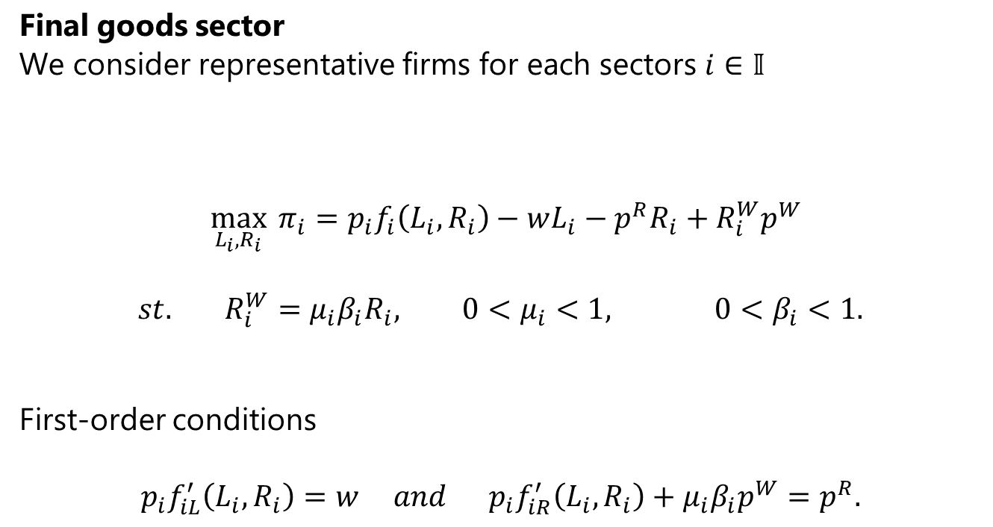
Small macro model
Final goods sector
We consider representative firms for each sectors $i∈𝕀$
$$\max_{L_{i},R_{i}}{π_{i}}=p_{i}f_{i}\left(L_{i},R_{i}\right)−wL_{i}−p^{R}R_{i}+R_{i}^{W}p^{W}$$
$$st. R_{i}^{W}=μ_{i}β_{i}R_{i}, 0<μ_{i}<1, 0<β_{i}<1.$$
First-order conditions
$$p_{i}f_{iL}^{′}\left(L_{i},R_{i}\right)=w and p_{i}f_{iR}^{′}\left(L_{i},R_{i}\right)+μ_{i}β_{i}p^{W}=p^{R}.$$

Slide 26
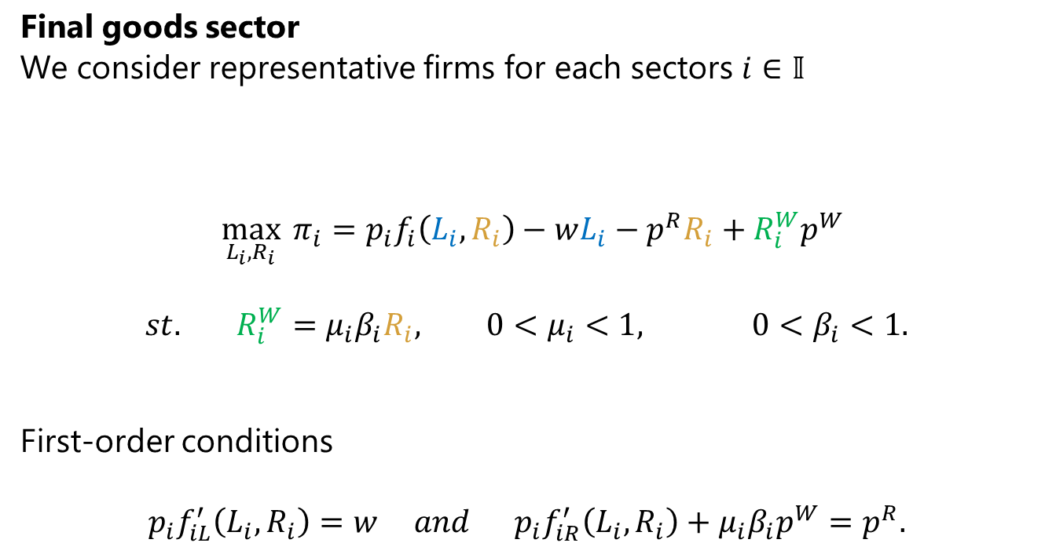
Small macro model
Final goods sector
We consider representative firms for each sectors $i∈𝕀$
$$\max_{L_{i},R_{i}}{π_{i}}=p_{i}f_{i}\left(L_{i},R_{i}\right)−wL_{i}−p^{R}R_{i}+R_{i}^{W}p^{W}$$
$$st. R_{i}^{W}=μ_{i}β_{i}R_{i}, 0<μ_{i}<1, 0<β_{i}<1.$$
First-order conditions
$$p_{i}f_{iL}^{′}\left(L_{i},R_{i}\right)=w and p_{i}f_{iR}^{′}\left(L_{i},R_{i}\right)+μ_{i}β_{i}p^{W}=p^{R}.$$
Natural resource input
Labour input
Recyclable waste

Slide 27
Small macro model
Final goods sector
We consider representative firms for each sectors $i∈𝕀$
$$\max_{L_{i},R_{i}}{π_{i}}=p_{i}f_{i}\left(L_{i},R_{i}\right)−wL_{i}−p^{R}R_{i}+R_{i}^{W}p^{W}$$
$$st. R_{i}^{W}=μ_{i}β_{i}R_{i}, 0<μ_{i}<1, 0<β_{i}<1.$$
First-order conditions
$$p_{i}f_{iL}^{′}\left(L_{i},R_{i}\right)=w and p_{i}f_{iR}^{′}\left(L_{i},R_{i}\right)+μ_{i}β_{i}p^{W}=p^{R}.$$
Marginal revenue from increased valuable waste output
Marginal revenue from increased production

Slide 28
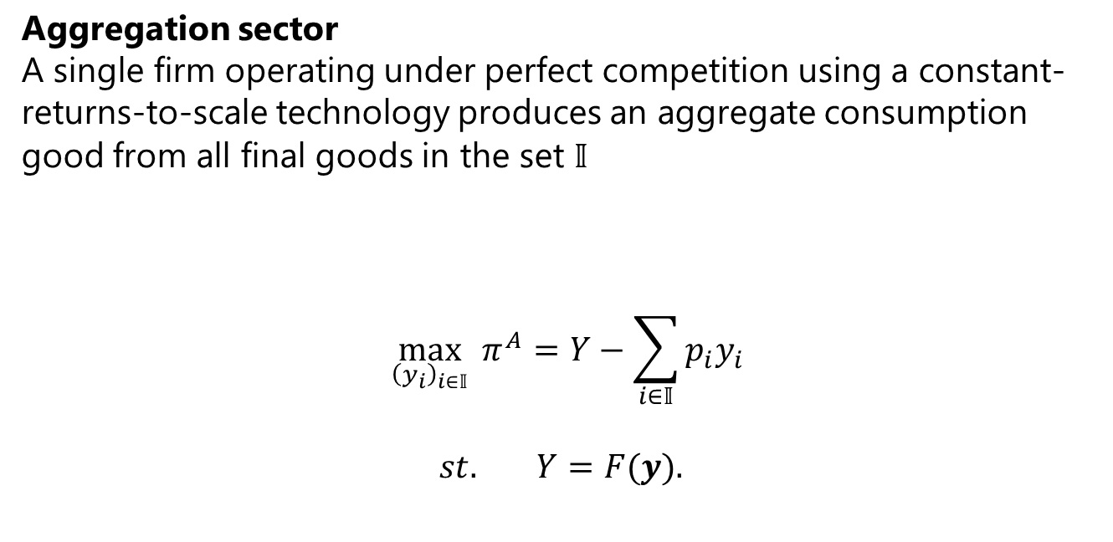
Small macro model
Aggregation sector
A single firm operating under perfect competition using a constant-returns-to-scale technology produces an aggregate consumption good from all final goods in the set $𝕀$
$$\max_{{\left(y_{i}\right)}_{i∈𝕀}}{π^{A}}=Y−\sum_{i∈𝕀}{p_{i}y_{i}}$$
$$st. Y=F(y).$$

Slide 29
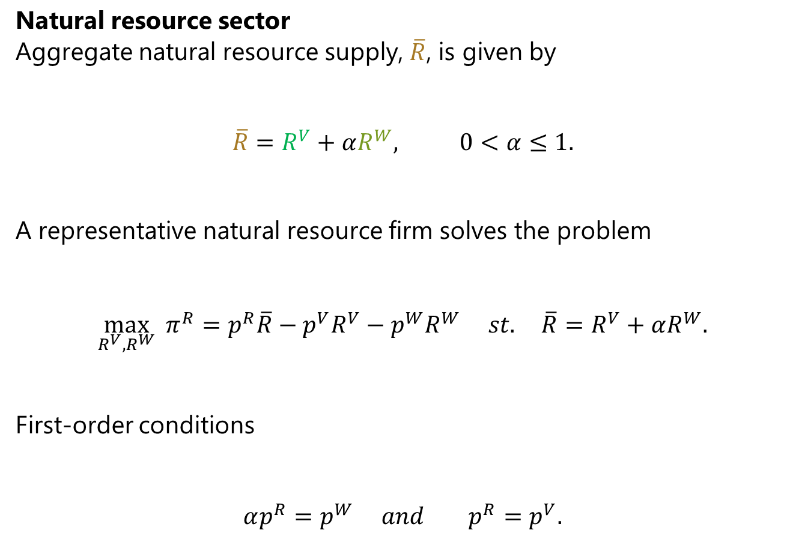
Small macro model
Natural resource sector
Aggregate natural resource supply, $\overline{R}$, is given by
$$\overline{R}=R^{V}+αR^{W}, 0<α≤1.$$
A representative natural resource firm solves the problem
$$\max_{R^{V}, R^{W}}{π^{R}}=p^{R}\overline{R}−p^{V}R^{V}−p^{W}R^{W} st. \overline{R}=R^{V}+αR^{W}.$$
First-order conditions
$$αp^{R}=p^{W} and p^{R}=p^{V}.$$
Recycled materials
Virgin natural resources/primary materials

Slide 30
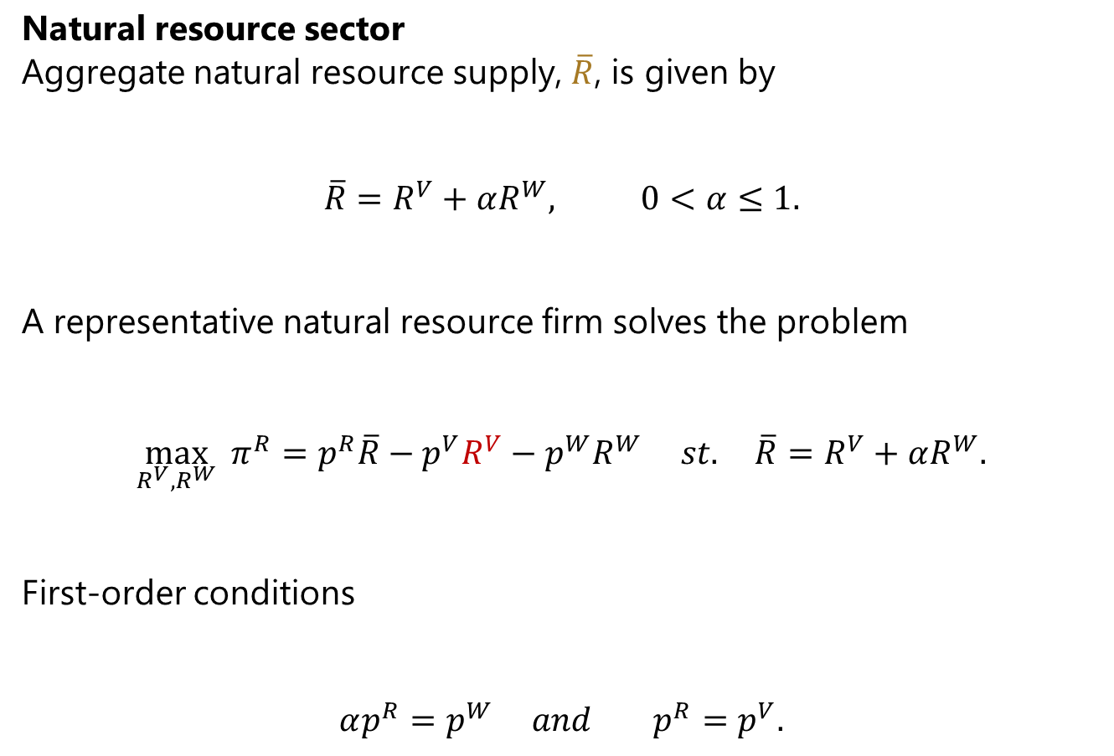

Small macro model
Natural resource sector
Aggregate natural resource supply, $\overline{R}$, is given by
$$\overline{R}=R^{V}+αR^{W}, 0<α≤1.$$
A representative natural resource firm solves the problem
$$\max_{R^{V}, R^{W}}{π^{R}}=p^{R}\overline{R}−p^{V}R^{V}−p^{W}R^{W} st. \overline{R}=R^{V}+αR^{W}.$$
First-order conditions
$$αp^{R}=p^{W} and p^{R}=p^{V}.$$
Produced at a constant price $p^{V}$ or imported from abroad at a constant price $p^{V}$

Slide 31

Small macro model
Household sector
$$\max_{C}{u(C)} st. w\overline{L}+\sum_{i∈𝕀}{π_{i}}+π^{A}+π^{R}=C.$$
Equilibrium conditions
$$y_{i}=f_{i}(L_{i},R_{i})$$
$$\overline{R}=\sum_{i∈𝕀}{R_{i}}$$
$$R^{W}=\sum_{i∈𝕀}{R_{i}^{W}}$$
$$\overline{L}=\sum_{i∈𝕀}{L_{i}}$$

Slide 32
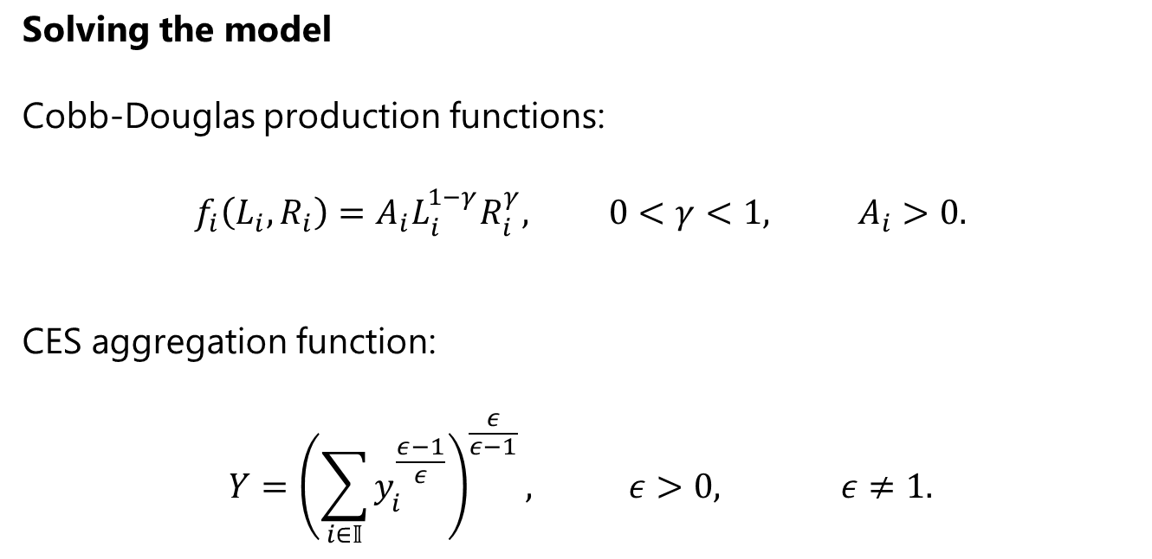
Small macro model
Solving the model
Cobb-Douglas production functions:
$$f_{i}\left(L_{i},R_{i}\right)=A_{i}L_{i}^{1−γ}R_{i}^{γ}, 0<γ<1, A_{i}>0.$$
CES aggregation function:
$$Y={\left(\sum_{i∈𝕀}{y_{i}^{\frac{ε−1}{ε}}}\right)}^{\frac{ε}{ε−1}}, ε>0, ε≠1.$$

Slide 33
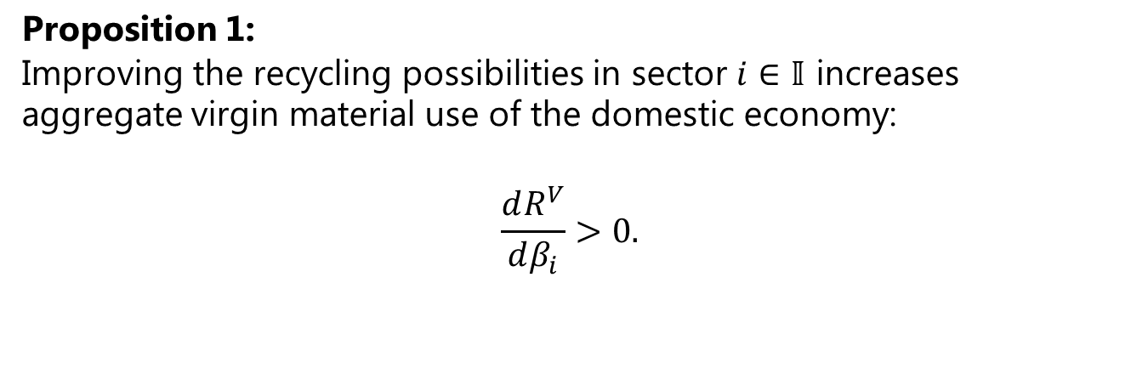
Small macro model
Proposition 1:
Improving the recycling possibilities in sector $i∈𝕀$ increases aggregate virgin material use of the domestic economy:
$$\frac{dR^{V}}{dβ_{i}}>0.$$

Slide 34
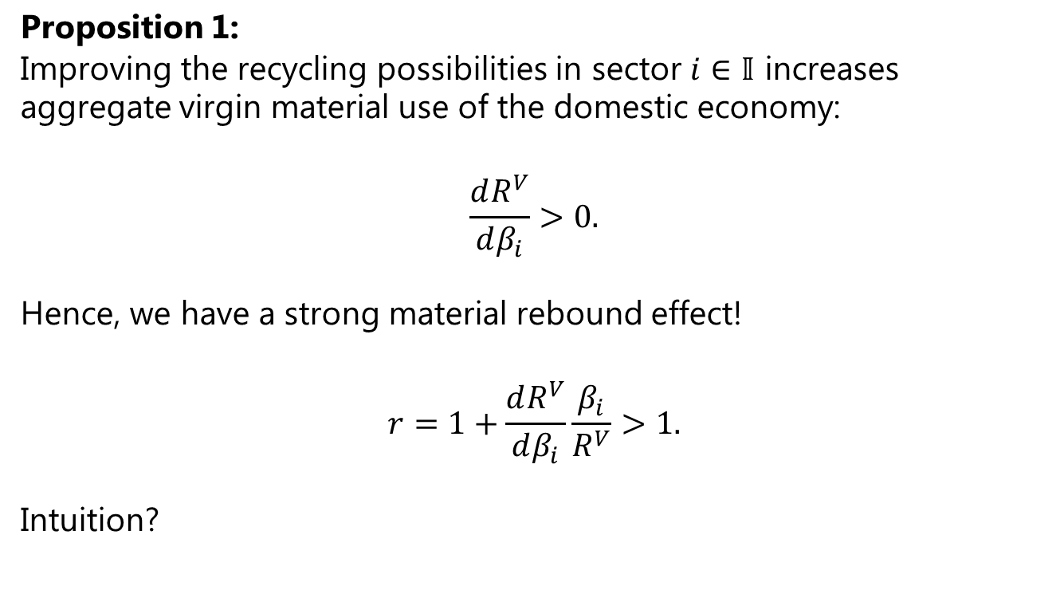
Small macro model
Proposition 1:
Improving the recycling possibilities in sector $i∈𝕀$ increases aggregate virgin material use of the domestic economy:
$$\frac{dR^{V}}{dβ_{i}}>0.$$
Hence, we have a strong material rebound effect!
$$r=1+\frac{dR^{V}}{dβ_{i}}\frac{β_{i}}{R^{V}}>1.$$
Intuition?

Slide 35
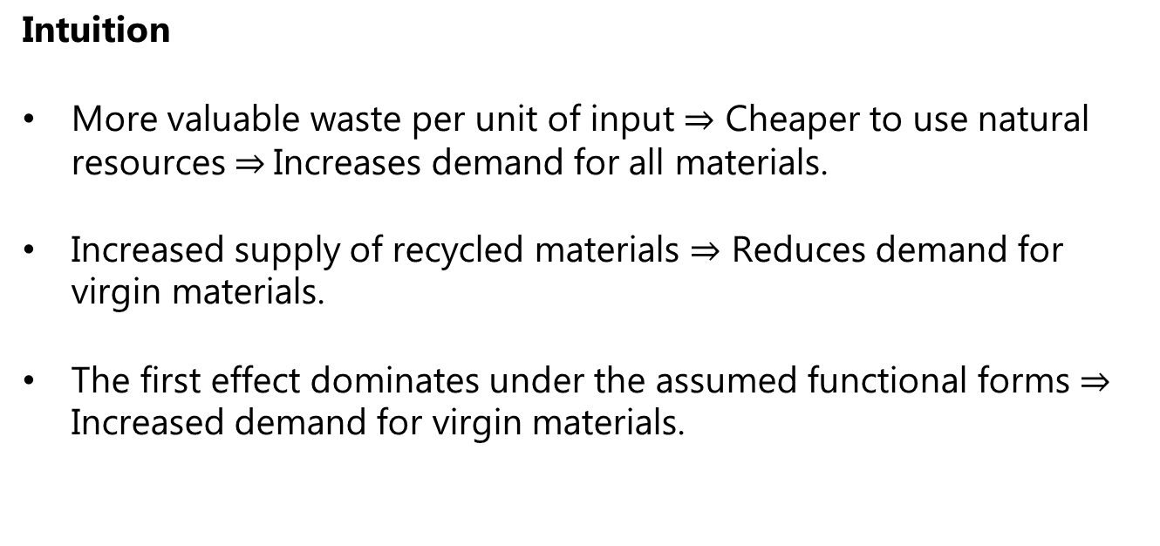
Small macro model
Intuition
More valuable waste per unit of input $⇒$ Cheaper to use natural resources $⇒$Increases demand for all materials.
Increased supply of recycled materials $⇒$ Reduces demand for virgin materials.
The first effect dominates under the assumed functional forms $⇒$ Increased demand for virgin materials.

Slide 36
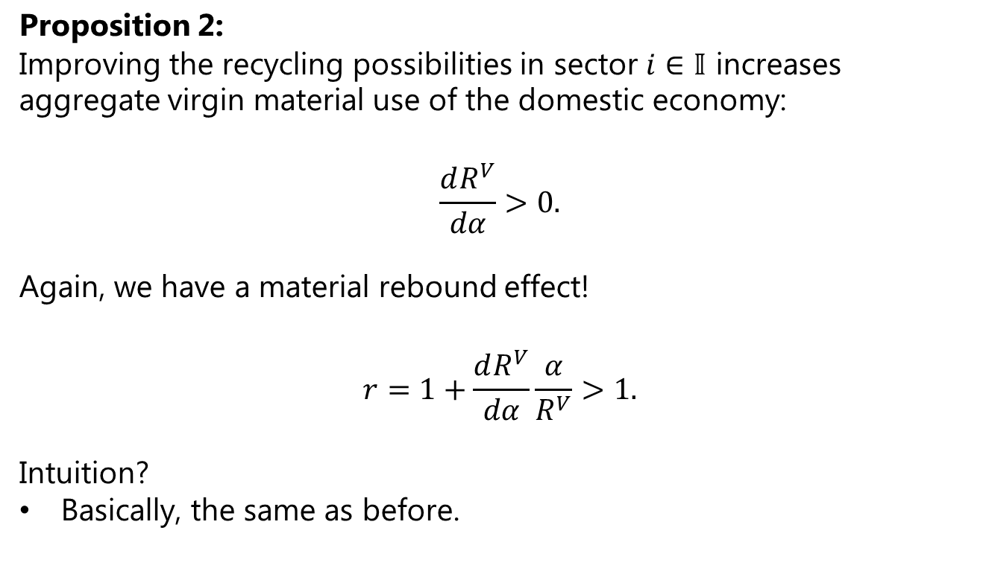
Small macro model
Proposition 2:
Improving the recycling possibilities in sector $i∈𝕀$ increases aggregate virgin material use of the domestic economy:
$$\frac{dR^{V}}{dα}>0.$$
Again, we have a material rebound effect!
$$r=1+\frac{dR^{V}}{dα}\frac{α}{R^{V}}>1.$$
Intuition?
Basically, the same as before.

Slide 37
Small macro model
What did we learn and where to go?
We learned that we can get a strong rebound effect in a small macroeconomic model without imposing controversial assumptions.
Next, we want to develop an advanced numerical model calibrated to national accounts and material flow account data to compute likely rebound effects for a real-world economy.

Slide 38
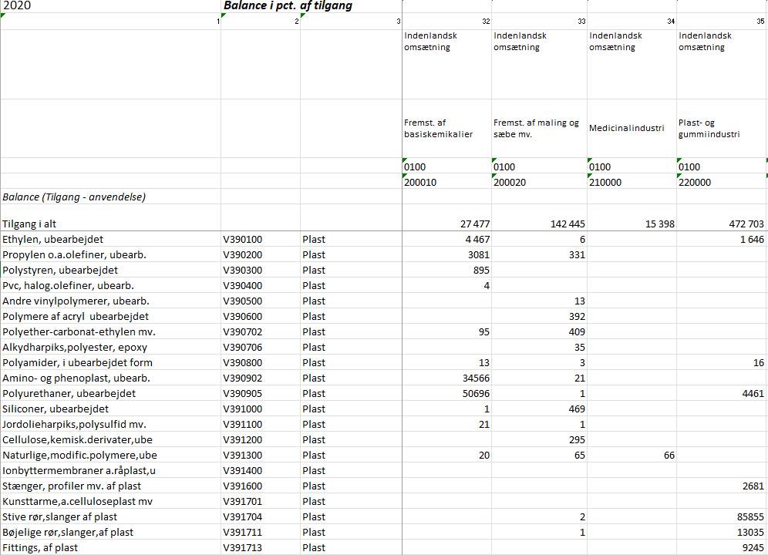
Data
Material Flow Accounts
Physical supply-use tables (PSUTs) for 2020 cover 1,947 commodities used by 120 industries, for final consumption, and for export.

Slide 39
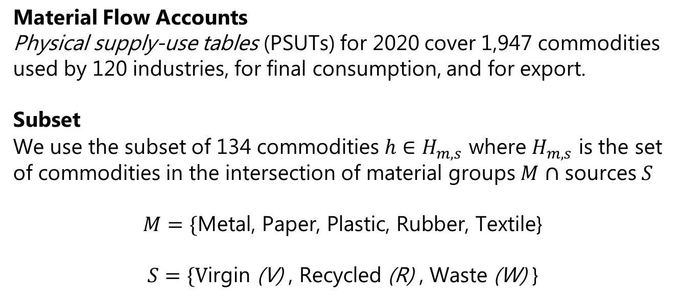
Data
Material Flow Accounts
Physical supply-use tables (PSUTs) for 2020 cover 1,947 commodities used by 120 industries, for final consumption, and for export.
Subset
We use the subset of 134 commodities $h∈H_{m,s}$ where $H_{m,s}$ is the set of commodities in the intersection of material groups $M$ $∩$ sources $S$
$$M=\{\text{Metal}\text{, }\text{Paper}\text{, }\text{Plastic}\text{, }\text{Rubber}\text{, }\text{Textile}\text{\}}$$
$$S=\{\text{V}\text{irgin} \text{(}\text{V}\text{)} \text{, }\text{R}\text{ecycled}\text{ (}\text{R}\text{) }\text{, }\text{W}\text{aste} \text{(}\text{W}\text{)} \text{\}}$$

Slide 40

Data
Aggregate quantities
We then aggregate $h$ by source $s$and material group $m$, e.g., plastics:
 | Supply of plastics (kt) |  |  |  | Use of plastics (kt)
 | Prod | Cons | SWM | Imp | Prod | Cons | SWM | Exp
V | 104 |  |  | 734 | 729 | 0 |  | 109
R | 3 |  | 43 | 15 | 54 |  |  | 6
W | 53 | 76 | 1 | 16 |  |  | 78 | 68

Slide 41
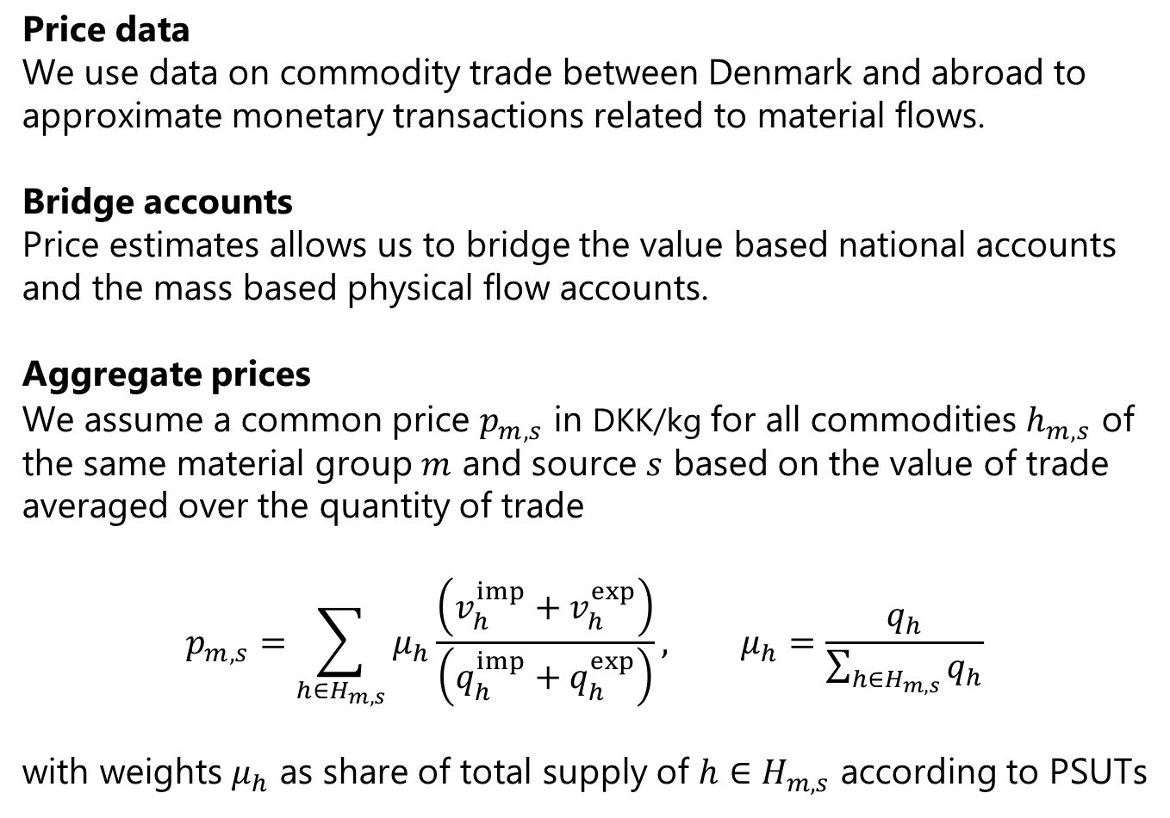
Data
Price data
We use data on commodity trade between Denmark and abroad to approximate monetary transactions related to material flows.
Bridge accounts
Price estimates allows us to bridge the value based national accounts and the mass based physical flow accounts.
Aggregate prices
We assume a common price $p_{m,s}$ in DKK/kg for all commodities $h_{m,s}$ of the same material group $m$ and source $s$ based on the value of trade averaged over the quantity of trade
$$p_{m,s}=\sum_{h∈H_{m,s}}{μ_{h}\frac{\left(v_{h}^{imp}+v_{h}^{exp}\right)}{\left(q_{h}^{imp}+q_{h}^{exp}\right)}}, μ_{h}=\frac{q_{h}}{\sum_{h∈H_{m,s}}{q_{h}}}$$
with weights $μ_{h}$ as share of total supply of $h∈H_{m,s}$ according to PSUTs

Slide 42
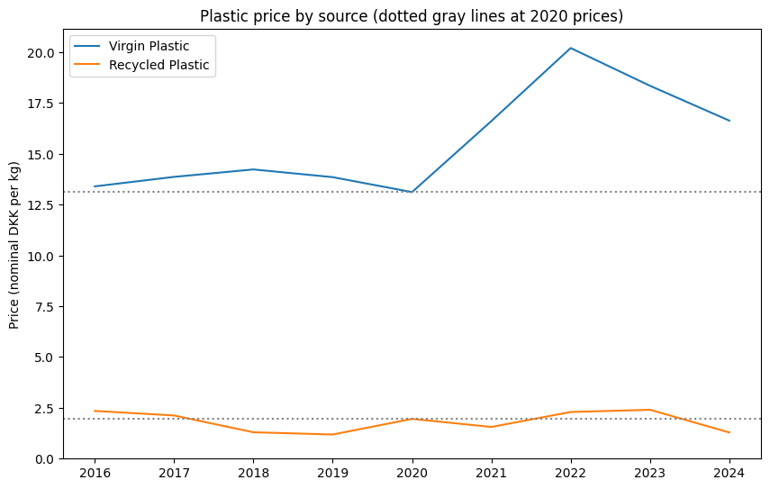
Data

Slide 43
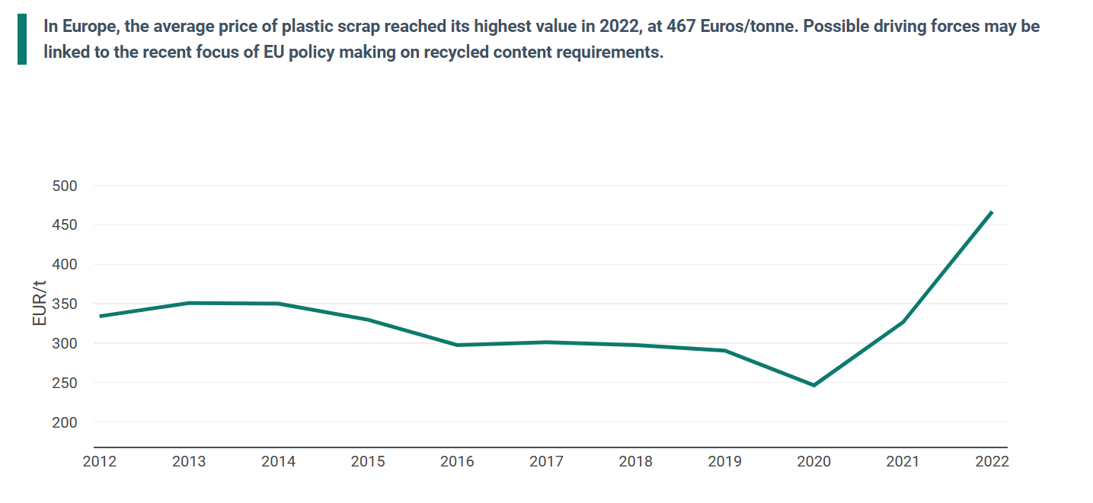
Data
Source: EEA.

Slide 44
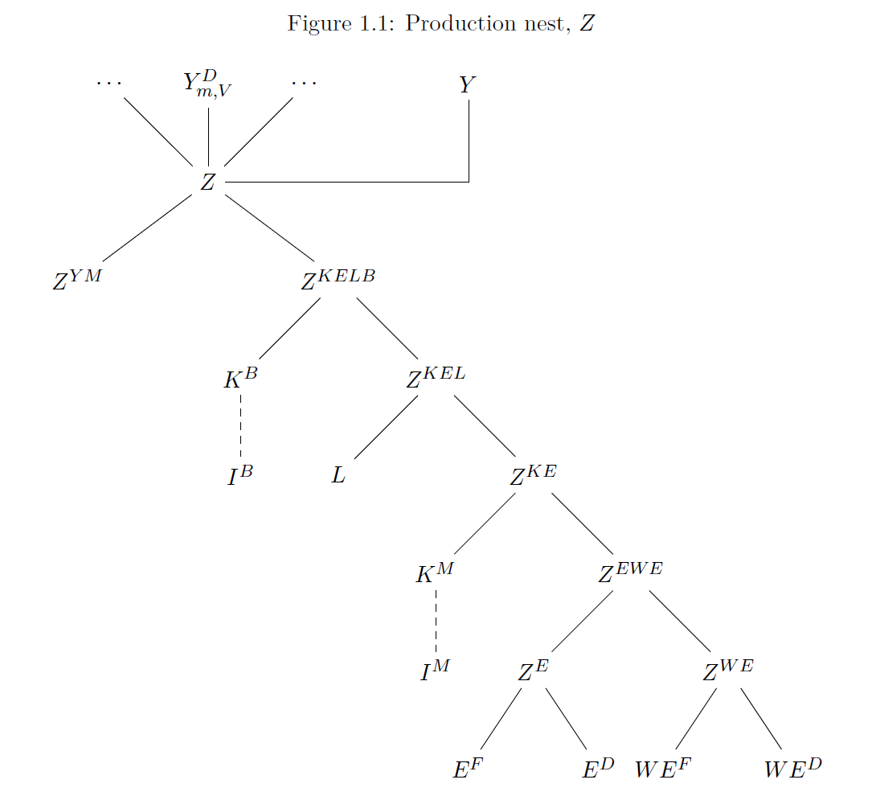
Numerical model
Production structure

Slide 45
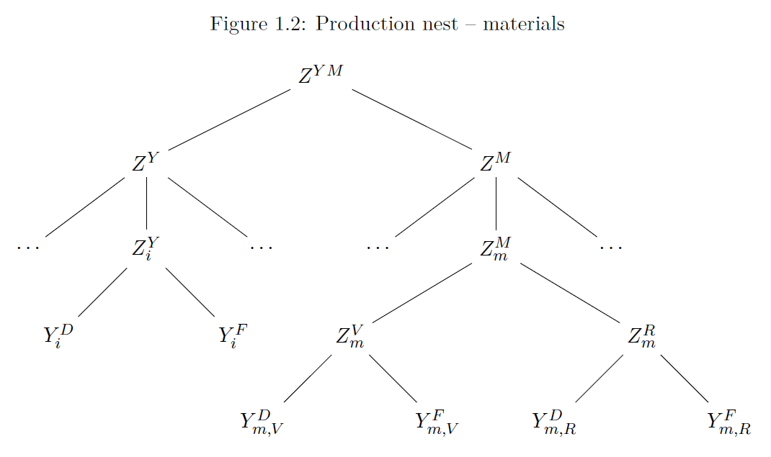
Numerical model
Production of materials

Slide 46
Numerical model
Waste generation
Waste generation depends on production inputs.
A fraction is “internal recycling” meaning that the sector ensures that it can be sold on the international market.
The remaining fraction is sent to the waste management sector for further treatment.
Waste intensities vary over time, industry, goods, and waste types.

Slide 47




Numerical model
Waste treatment sector
Export
Import

Slide 48


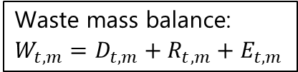
Numerical model
Waste treatment sector
Export
Waste mass balance:
$$W_{t,m}=D_{t,m}+R_{t,m}+E_{t,m}$$
Import

Slide 49


Numerical model
Waste treatment sector
Export
Import

Slide 50
Numerical model
Waste treatment sector
Export
Import

Slide 51
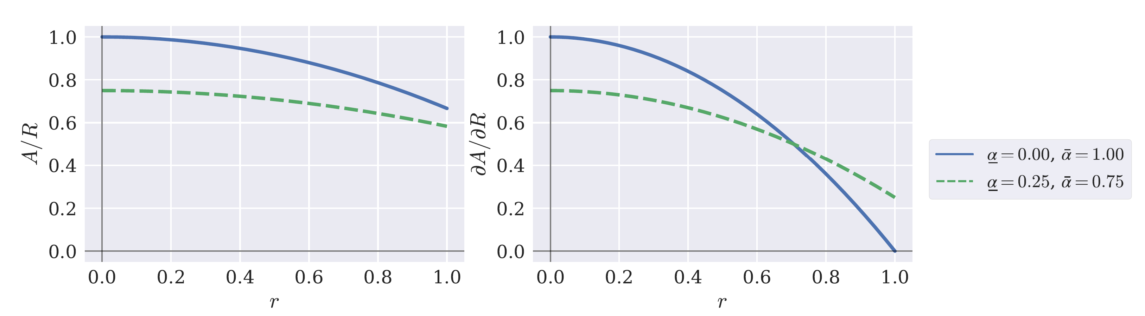
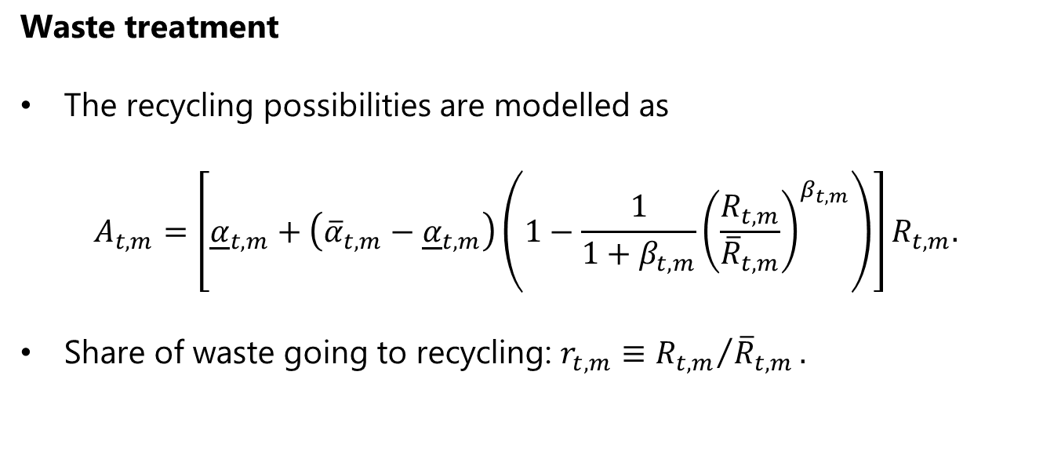
Numerical model
Waste treatment
The recycling possibilities are modelled as
$$A_{t,m}=\left[{\underline{α}}_{t,m}+\left({\overline{α}}_{t,m}−{\underline{α}}_{t,m}\right)\left(1−\frac{1}{1+β_{t,m}}{\left(\frac{R_{t,m}}{{\overline{R}}_{t,m}}\right)}^{β_{t,m}}\right)\right]R_{t,m}.$$
Share of waste going to recycling: $r_{t,m}≡{R_{t,m}}/{{\overline{R}}_{t,m}}.$

Slide 52
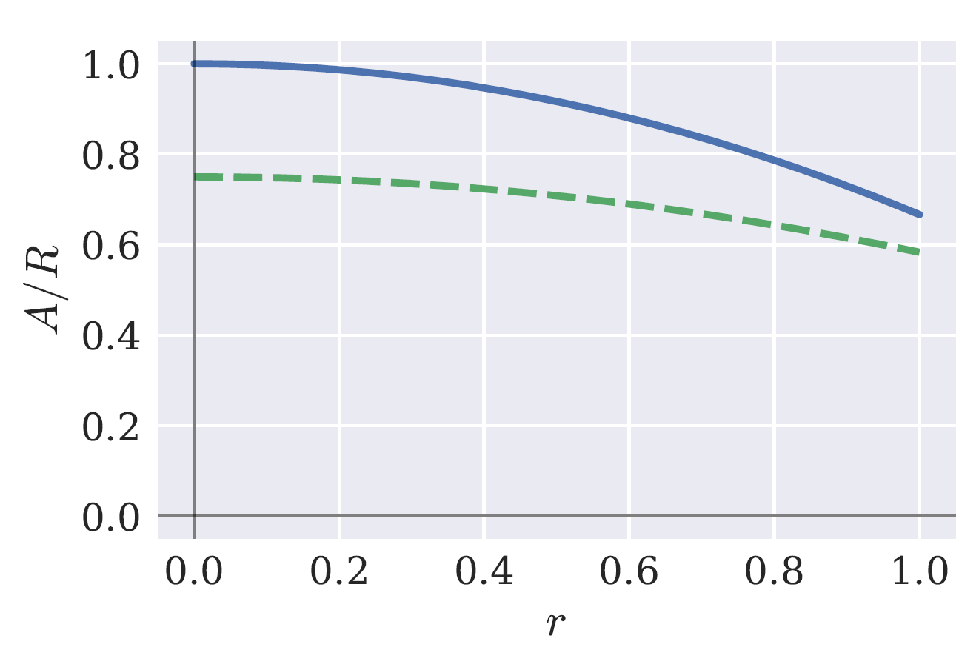
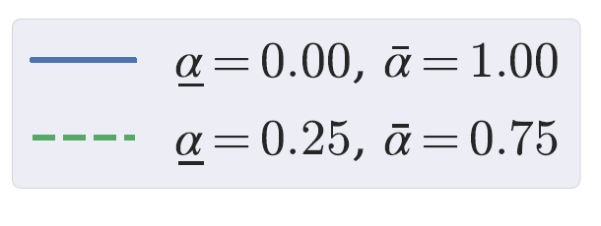
Numerical model
Waste treatment

Slide 53
Numerical model
Current calibration
We consider the Danish economy from 2020 (base year) and forward.
The Danish economy has excellent material flow account data, that we can exploit, but our model could, in principle, be calibrated to any economy.
We have 11 production sectors:
Four resource-intensive manufacturing sectors (metals, paper, rubber and plastics, and textiles).
Other manufacturing [relatively low resource use]
Three other production sectors [high waste production].
Energy sector.
The recycling sector.
The Government.

Slide 54
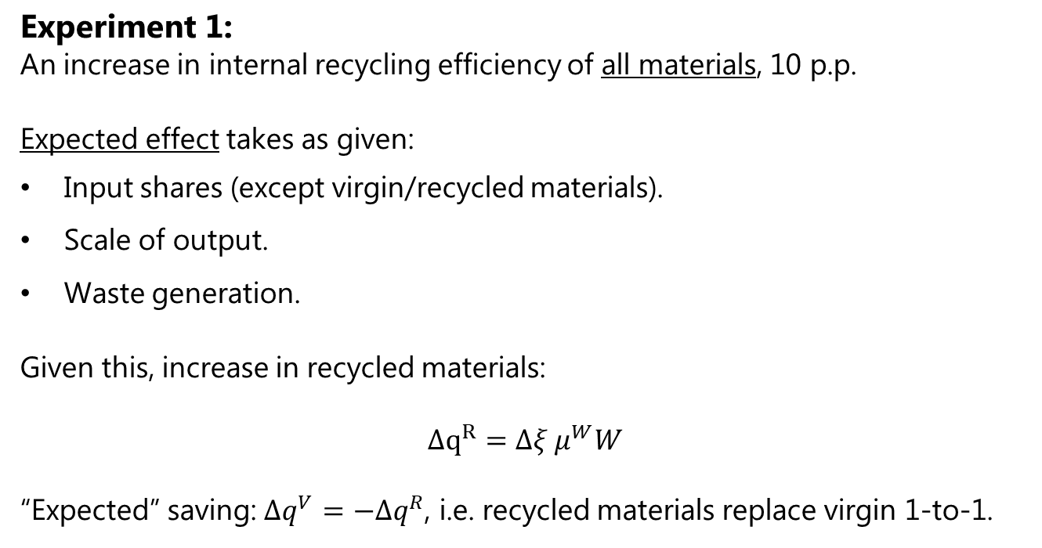
Results
Experiment 1:
An increase in internal recycling efficiency of all materials, 10 p.p.
Expected effect takes as given:
Input shares (except virgin/recycled materials).
Scale of output.
Waste generation.
Given this, increase in recycled materials:
$$Δq^{R}=Δξ μ^{W}W$$
“Expected” saving: $Δq^{V}=−Δq^{R}$, i.e. recycled materials replace virgin 1-to-1.

Slide 55
Results
Experiment 1:
Export
Here
Import

Slide 56
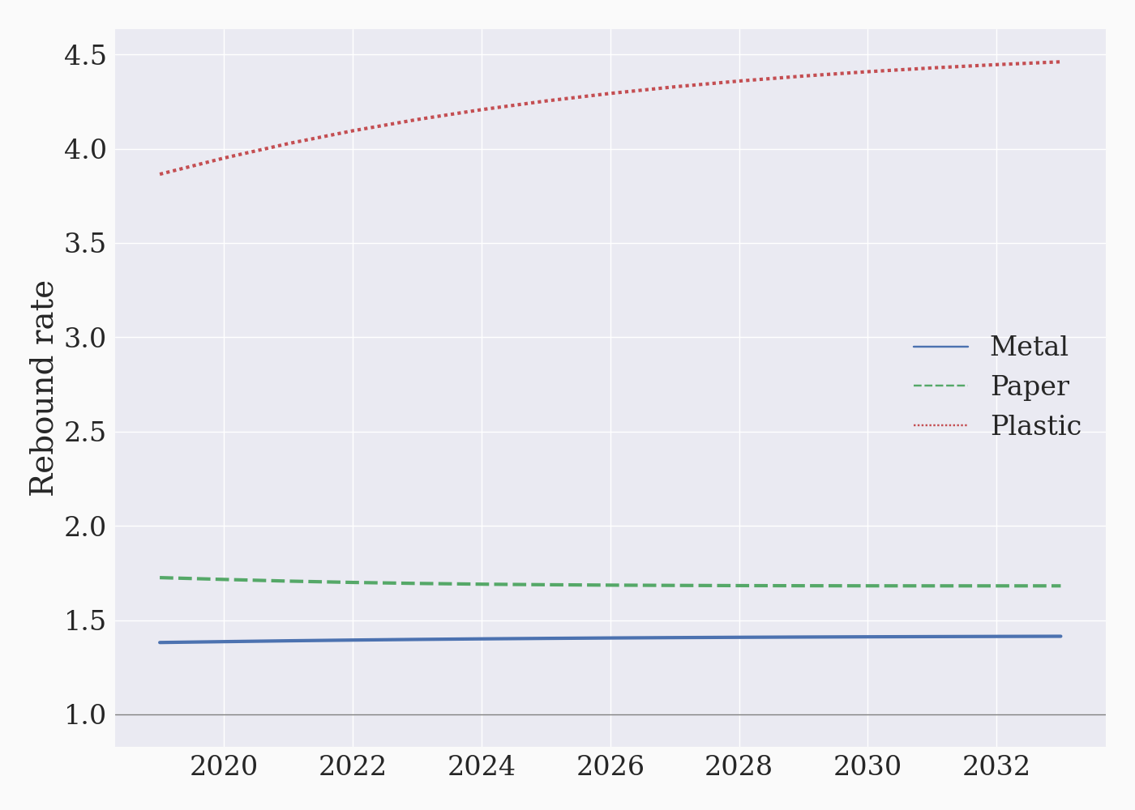
Results
Experiment 1:

Slide 57
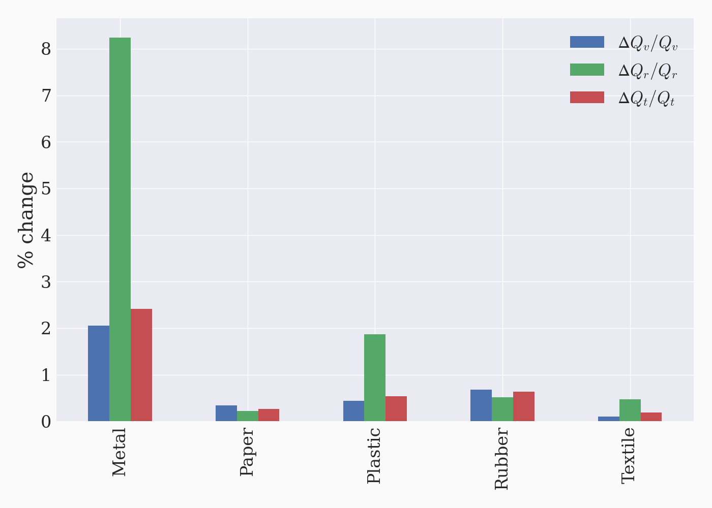
Results
Relative change in virgin, recycled, and total material use.
Experiment 1:

Slide 58
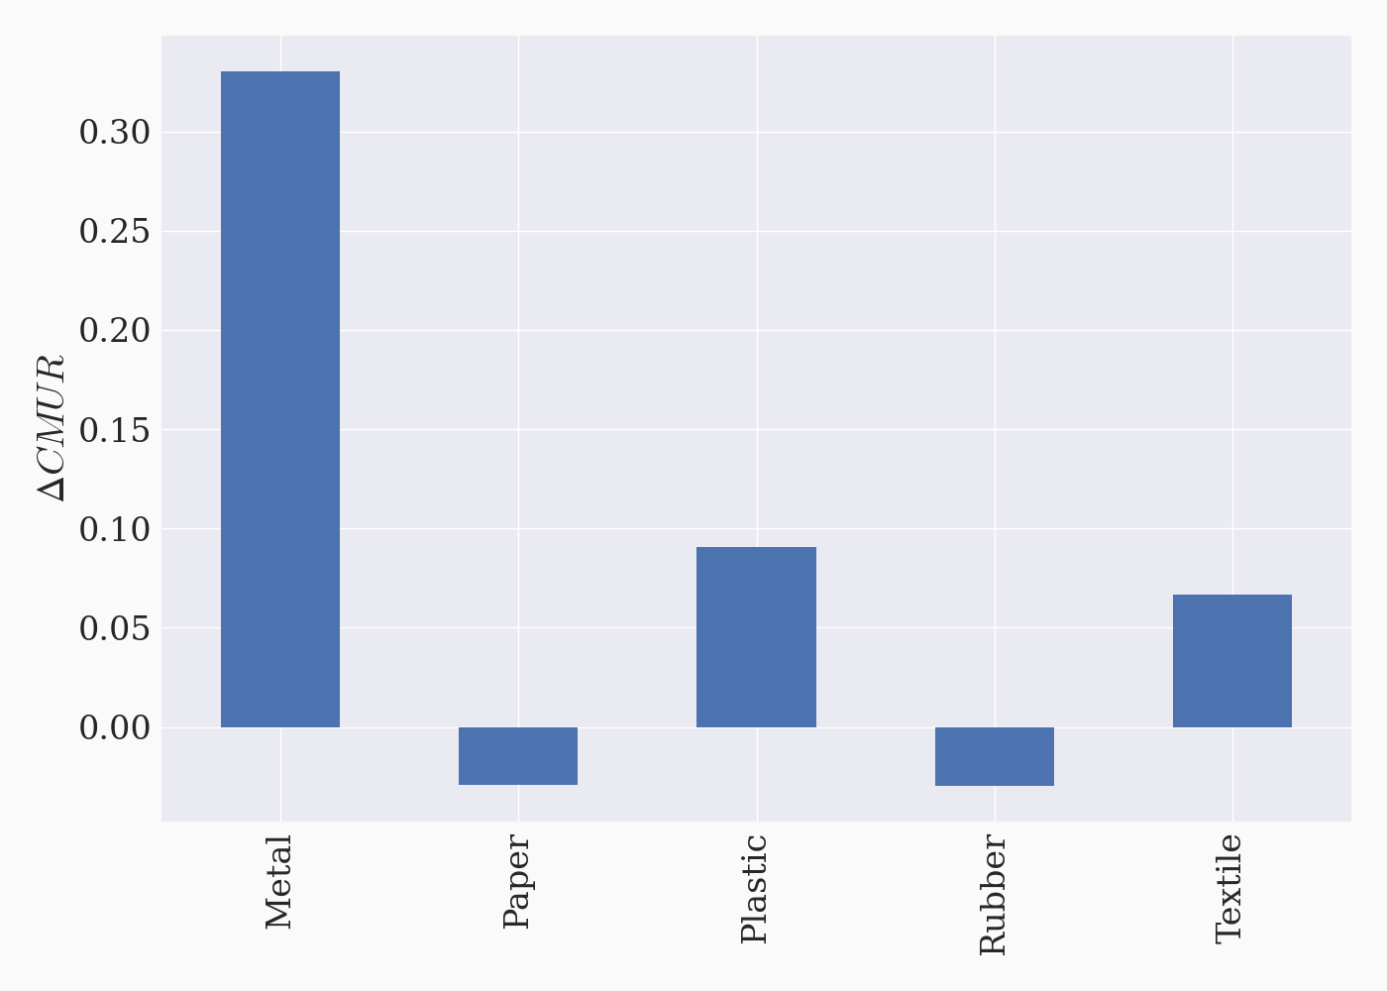
Results
Experiment 1:
Circular material use rates (CMUR):

Slide 59
Results
Experiment 1:
An increase in internal recycling efficiency of all materials, 10 p.p.
Result:
More recycled materials (also relative to virgin).
CMUR indicates progress (albeit marginal for most materials).
But: Rebound effect backfires throughout.

Slide 60
Results
Experiment 2:
An increase in internal recycling efficiency of one material only, 10 p.p.

Slide 61
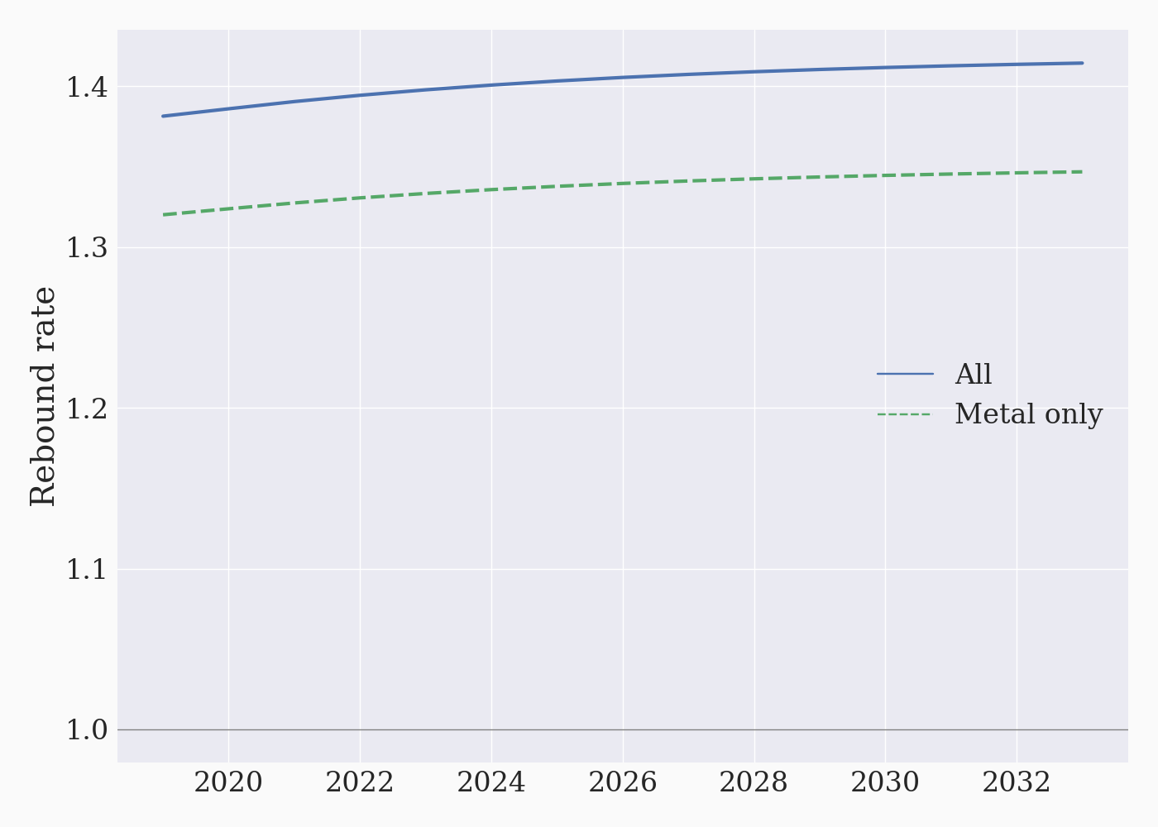
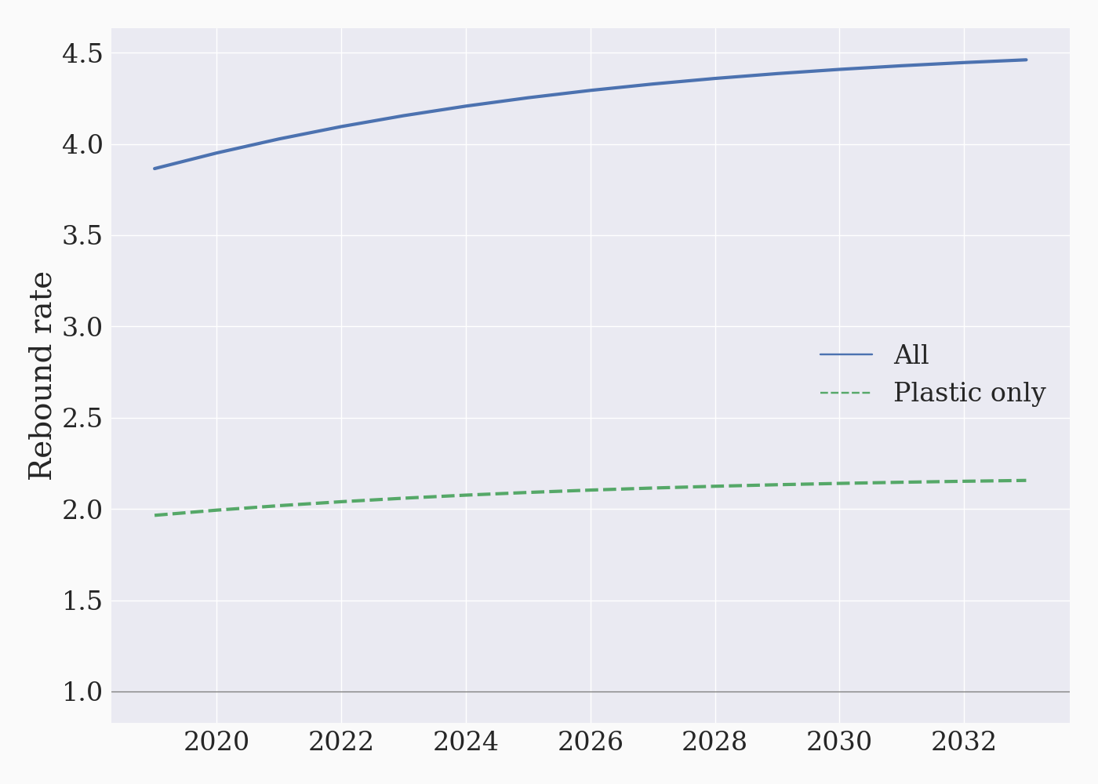
Results
Experiment 2:
(a) Metal
(b) Plastic

Slide 62
Results
Experiment 2:
An increase in internal recycling efficiency of one material only, 10 p.p.
Result: Scale effects are compounding.
More recycled metal increases scale of production and demand for all materials.
Whereas virgin metal is a substitute for recycled metal, other materials are generally complementary inputs (elasticity of subst. <1).
Metal drives up scale significantly → demand for plastic inputs increase significantly.

Slide 63
Results
Experiment 3:
More effective recycling in waste treatment plants, metal only.
Export
Import
Here

Slide 64
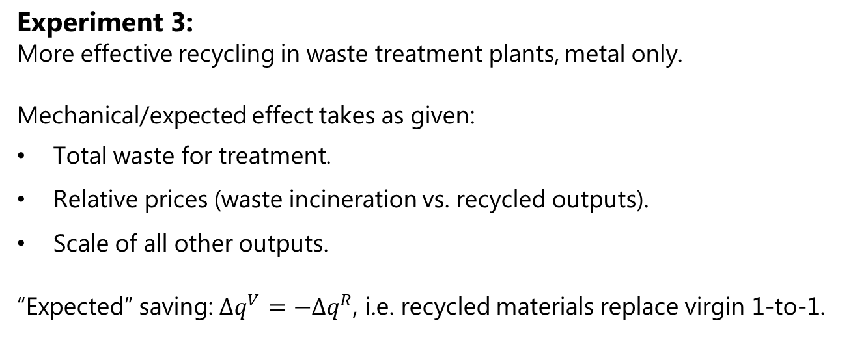
Results
Experiment 3:
More effective recycling in waste treatment plants, metal only.
Mechanical/expected effect takes as given:
Total waste for treatment.
Relative prices (waste incineration vs. recycled outputs).
Scale of all other outputs.
“Expected” saving: $Δq^{V}=−Δq^{R}$, i.e. recycled materials replace virgin 1-to-1.

Slide 65
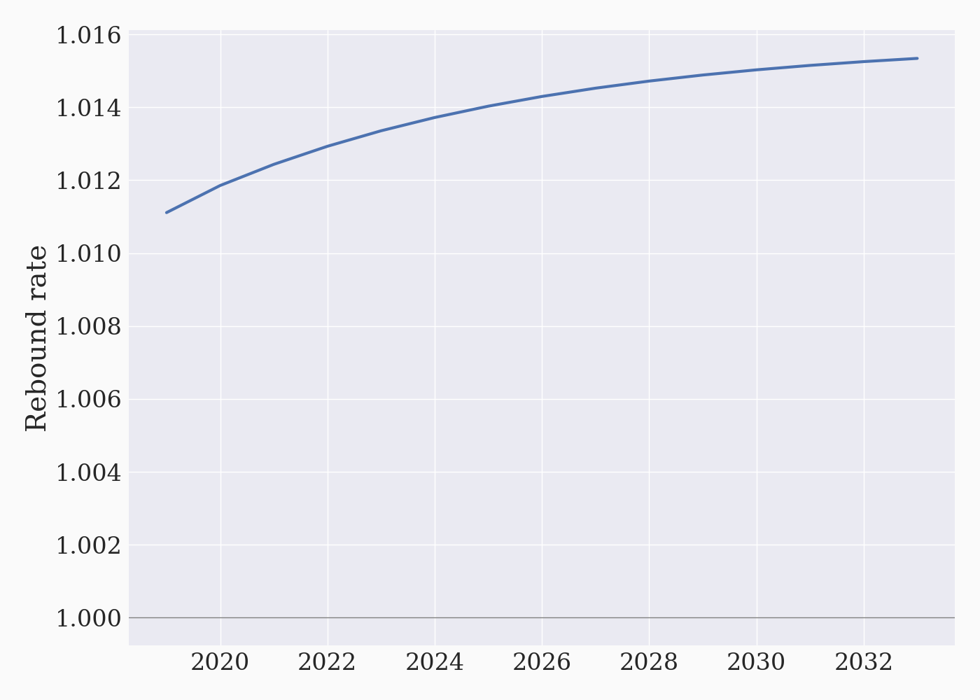
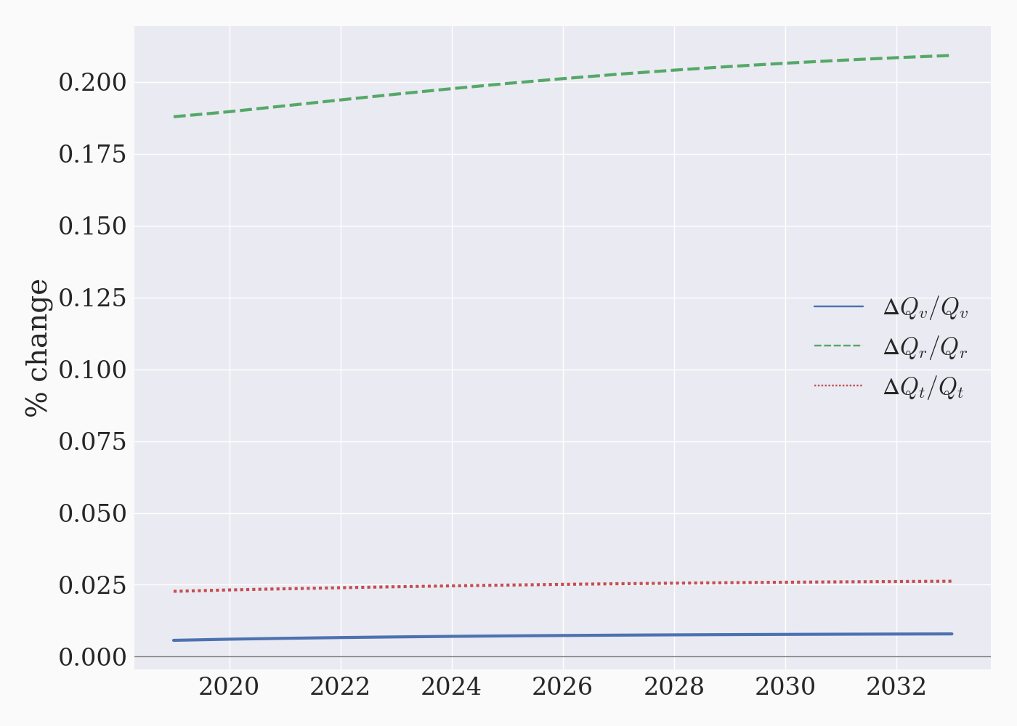
Results
Experiment 3:
(a) Rebound rate
(b) Material throughput

Slide 66
Results
Experiment 4:
Implement ad-valorem tax on the demand for virgin materials, 10%.
Here we cannot calculate an expected effect, hence we cannot compute the rebound effect.

Slide 67
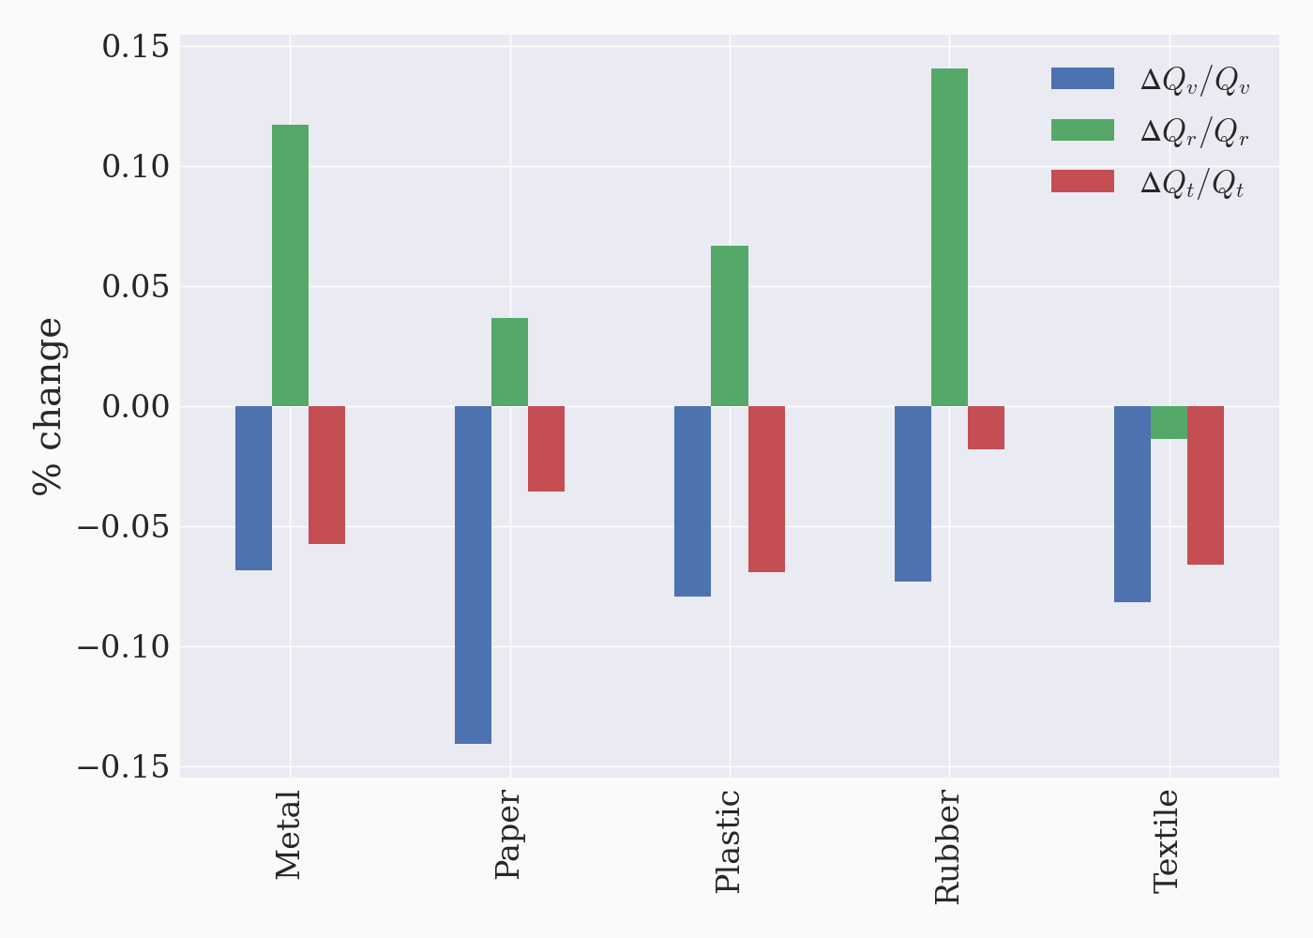
Results
Experiment 4:
Substitution away from virgin materials, towards recycled.
Relative change in virgin, recycled, and total material use.

Slide 68
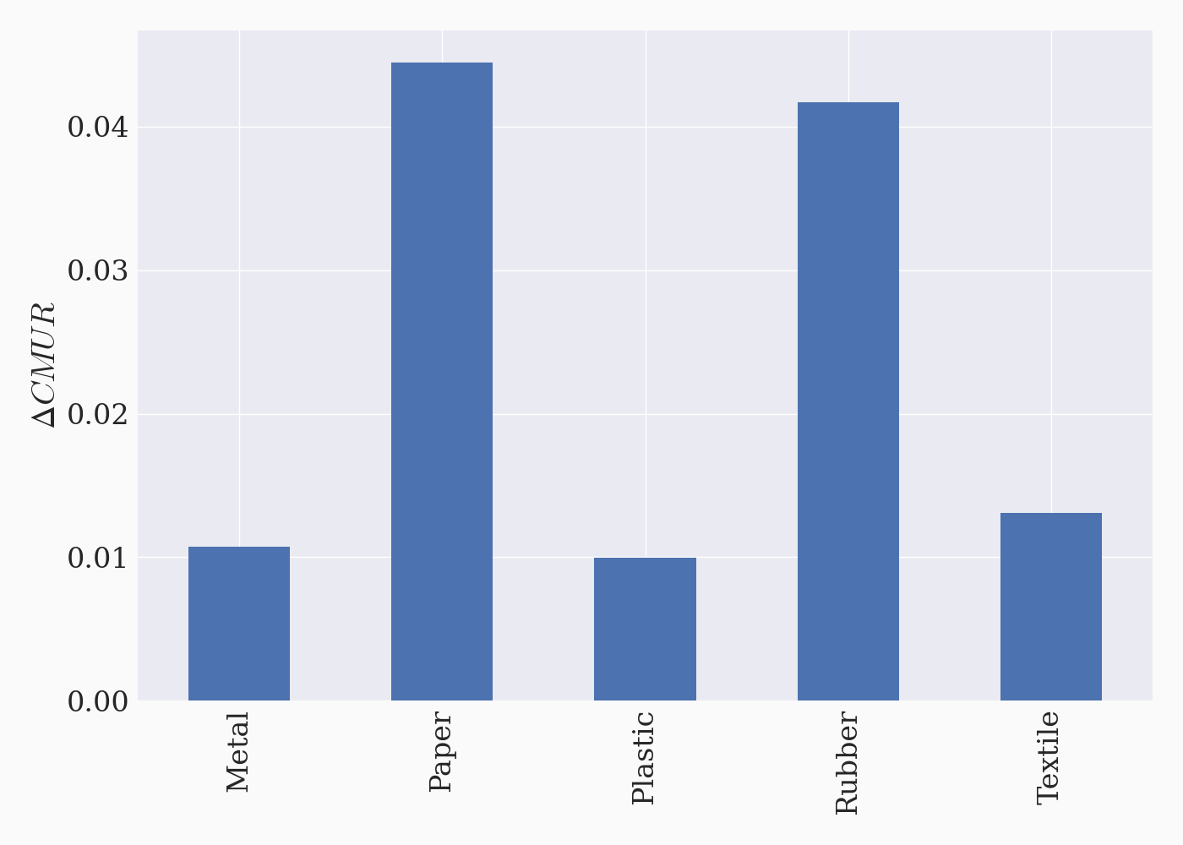
Results
Experiment 4:
Circular Material Use Rate “improves” as well.

Slide 69
Results
Experiment 4:
Implement ad-valorem tax demand for virgin materials, 10%.
Result:
Increases recycling, decreases virgin material consumption.
Recycling may go down (‘textile’)
Substitution effect: Use recycled textile instead of virgin.
Scale effect: More expensive production → lower output → material demand in general.
Cross-substitution: Total metal demand is lower → less demand for textile (complementary input).

Slide 70
Discussion
How to avoid the material rebound effect
The problem with Circular Economy Policies is often that they do not target the problem – use of primary materials – directly.
This is why these policies may backfire.
Probably a combination of instruments is needed.
Egger and Keuschnigg (2024) find that a trash tax together with a recycling subsidy is needed to obtain the first-best allocation.
But so far, we have only identified one policy – a tax on virgin material use – that systematically avoid backfire.
We need to be careful with our circular economy targets!

Slide 71
Discussion
EU plans to double its ‘Circular Material Use Rate’ from 2020 to 2030
10.7%

Slide 72
Concluding remarks
The aim of this study is not to discourage a transition toward a circular economy.
But we highlight that Circular Economy Policies can backfire.
Hence, we need to carefully design such policies to obtain environmental benefits as well as resource security benefits.
We also develop a new modelling framework that could be employed in any small open economy as long as material flow accounts are available.
We will probably also develop a large open economy version of our model.
Finally, our results suggest that Circular Material Use Rate targets can be counter productive → these targets might improve while the economy increases primary (virgin) material use.

Slide 73
Appendix
Observation: Waste can be valuable
Source: Eurostat.

Slide 74
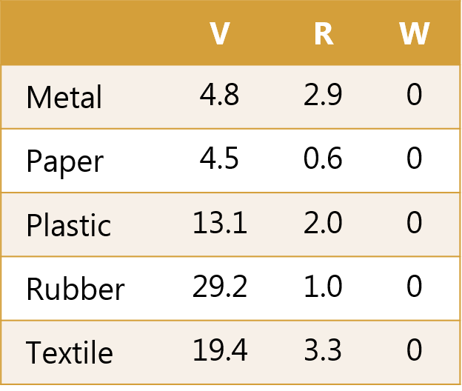
Appendix
Observation: Waste can be valuable
Material prices in DKK/kg by material group m and source s

Slide 75
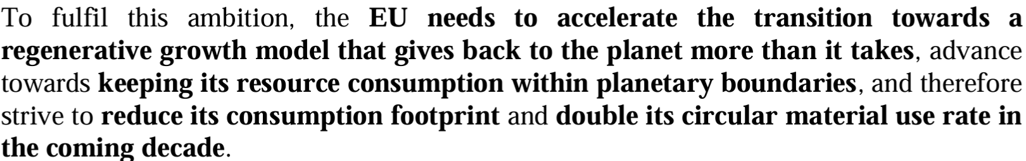
Appendix
EU plans to double its ‘Circular Material Use Rate’ from 2020 to 2030
Source: EU Commission (2020).
10.7%

Slide 76
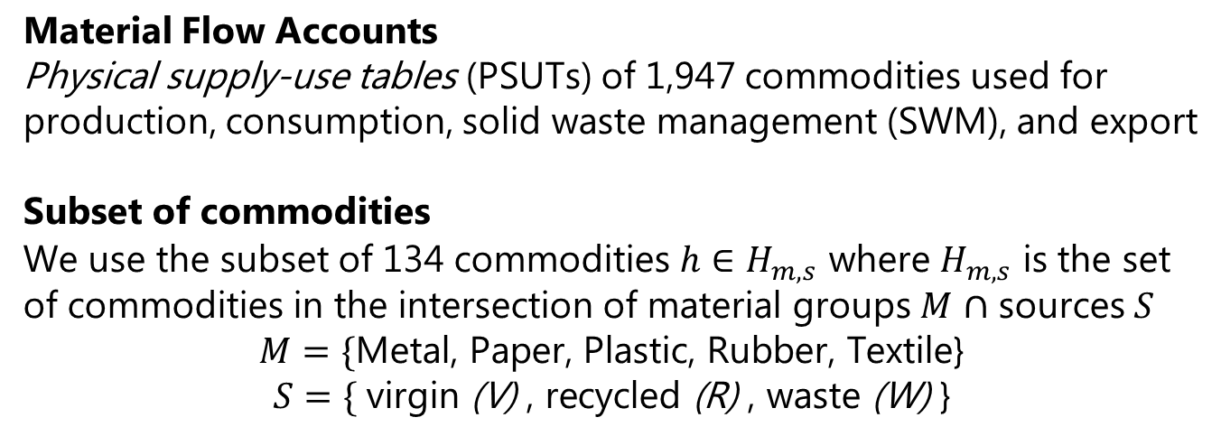
Appendix - Data
Material Flow Accounts
Physical supply-use tables (PSUTs) of 1,947 commodities used for production, consumption, solid waste management (SWM), and export
Subset of commodities
We use the subset of 134 commodities $h∈H_{m,s}$ where $H_{m,s}$ is the set of commodities in the intersection of material groups $M$ $∩$ sources $S$
$$M=\{\text{Metal}\text{, }\text{Paper}\text{, }\text{Plastic}\text{, }\text{Rubber}\text{, }\text{Textile}\text{\}}$$
$$S=\{ \text{virgin} \text{(}\text{V}\text{)} \text{, }\text{recycled}\text{ (}\text{R}\text{) }\text{, }\text{waste} \text{(}\text{W}\text{)} \text{\}}$$

Slide 77
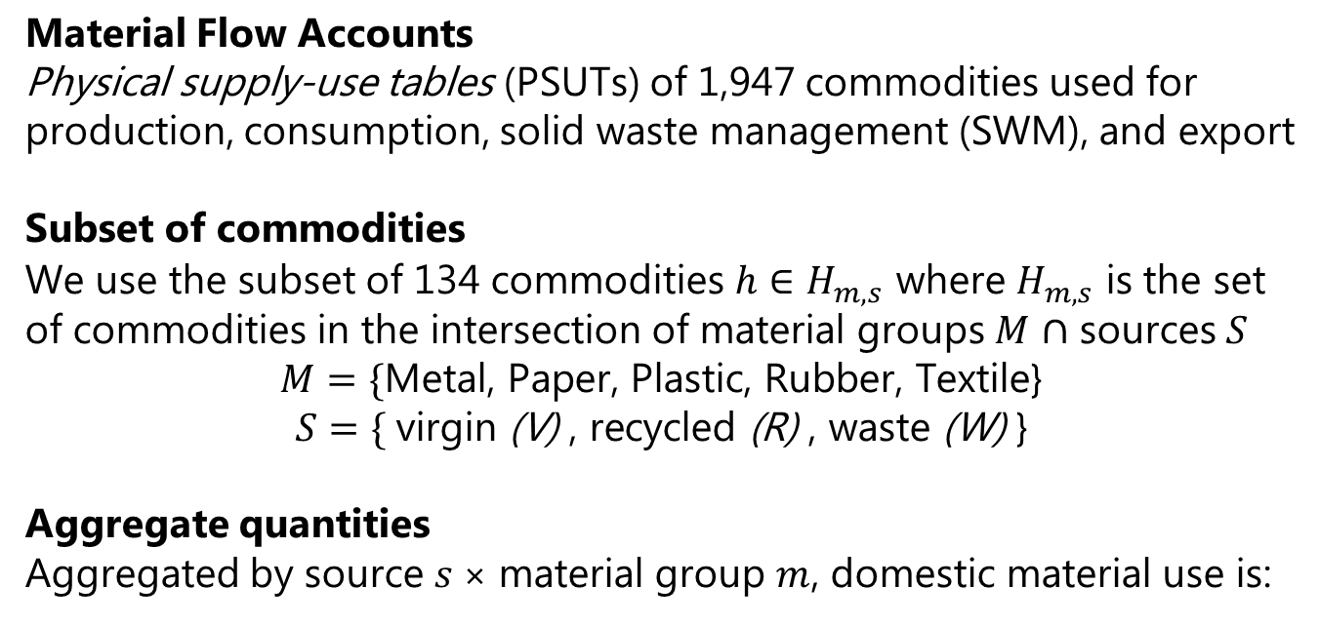
Appendix - Data
Material Flow Accounts
Physical supply-use tables (PSUTs) of 1,947 commodities used for production, consumption, solid waste management (SWM), and export
Subset of commodities
We use the subset of 134 commodities $h∈H_{m,s}$ where $H_{m,s}$ is the set of commodities in the intersection of material groups $M$ $∩$ sources $S$
$$M=\{\text{Metal}\text{, }\text{Paper}\text{, }\text{Plastic}\text{, }\text{Rubber}\text{, }\text{Textile}\text{\}}$$
$$S=\{ \text{virgin} \text{(}\text{V}\text{)} \text{, }\text{recycled}\text{ (}\text{R}\text{) }\text{, }\text{waste} \text{(}\text{W}\text{)} \text{\}}$$
Aggregate quantities
Aggregated by source $s$× material group $m$, domestic material use is:
 | Metal | Paper | Plastic | Rubber | Textile | Total
V (in kt) | 1,597 | 54 | 729 | 22 | 41 | 2,442
R (in kt) | 309 | 80 | 54 | 8 | 11 | 463
R (% of VR) | 16 | 59 | 7 | 28 | 22 | 16

Slide 78
Appendix - Data
Sector mapping
We aggregate the 120 industries of the PSUTs → 11 sectors where:
Energy and solid waste management are required for the model

Slide 79
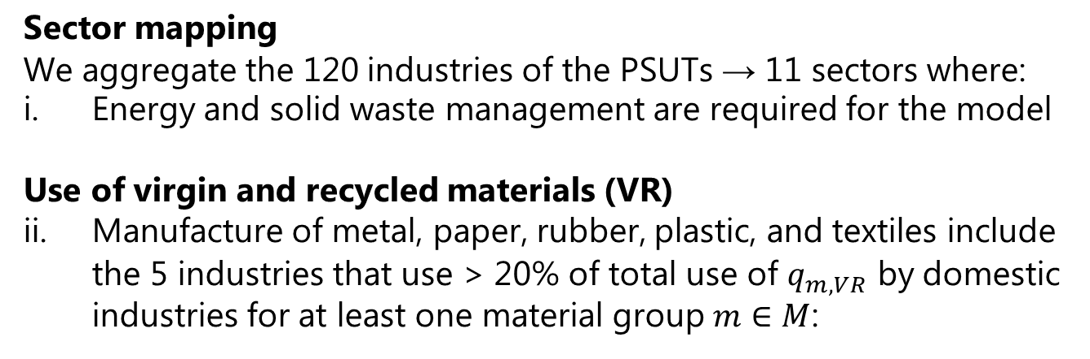
Appendix - Data
Sector mapping
We aggregate the 120 industries of the PSUTs → 11 sectors where:
Energy and solid waste management are required for the model
Use of virgin and recycled materials (VR)
Manufacture of metal, paper, rubber, plastic, and textiles include the 5 industries that use > 20% of total use of $q_{m,VR}$ by domestic industries for at least one material group $m∈M$:
Share of total use of q_{m,VR} by domestic industries (%) | Metal | Paper | Plastic | Rubber | Textile
Manufacture of metals and metal products | 65.02 | 0.00 | 3.43 | 8.34 | 0.29
Manufacture of paper and paper products | 0.13 | 85.87 | 4.81 | 5.29 | 0.77
Manufacture of rubber and plastic products | 0.30 | 0.00 | 50.85 | 37.85 | 5.52
Manufacture of textiles | 0.02 | 0.00 | 7.09 | 9.39 | 59.39
Other manufacturing | 20.32 | 6.34 | 31.75 | 38.84 | 9.81
Electricity and heating supply and transmission of electricity | 0.32 | 0.00 | 0.01 | 0.04 | 0.00
Solid waste management | 0.44 | 7.79 | 0.00 | 0.00 | 22.96
Construction | 2.41 | 0.00 | 0.00 | 0.15 | 0.00
Retail and wholesale and repair of motor vehicles etc. | 10.05 | 0.00 | 0.00 | 0.00 | 0.00
Public services | 0.23 | 0.00 | 0.00 | 0.00 | 0.50
Other industries | 0.77 | 0.00 | 2.05 | 0.09 | 0.75

Slide 80
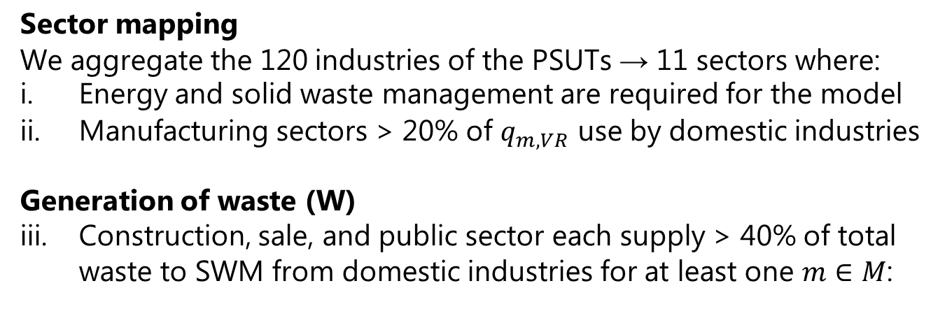
Appendix - Data
Sector mapping
We aggregate the 120 industries of the PSUTs → 11 sectors where:
Energy and solid waste management are required for the model
Manufacturing sectors > 20% of $q_{m,VR}$ use by domestic industries
Generation of waste (W)
Construction, sale, and public sector each supply > 40% of total waste to SWM from domestic industries for at least one $m∈M$:
Share of total supply of q_{m,W} by domestic industries (%) | Metal | Paper | Plastic | Rubber | Textile
Manufacture of metals and metal products | 13.53 | 0.63 | 2.06 | 1.60 | 0.00
Manufacture of paper and paper products | 0.06 | 4.38 | 0.62 | 0.00 | 0.00
Manufacture of rubber and plastic products | 0.49 | 0.86 | 25.13 | 0.92 | 0.00
Manufacture of textiles | 0.01 | 0.19 | 0.35 | 0.00 | 0.00
Other manufacturing | 14.08 | 21.44 | 21.75 | 0.89 | 0.00
Electricity and heating supply and transmission of electricity | 0.61 | 0.04 | 0.28 | 0.00 | 0.00
Solid waste management | 1.59 | 0.22 | 1.58 | 0.59 | 50.68
Construction | 46.08 | 1.03 | 9.46 | 1.42 | 0.00
Retail and wholesale and repair of motor vehicles etc. | 17.86 | 48.61 | 21.10 | 87.01 | 0.00
Public services | 0.53 | 5.26 | 1.61 | 0.32 | 42.47
Other industries | 5.15 | 17.33 | 16.06 | 7.25 | 6.85

Slide 81
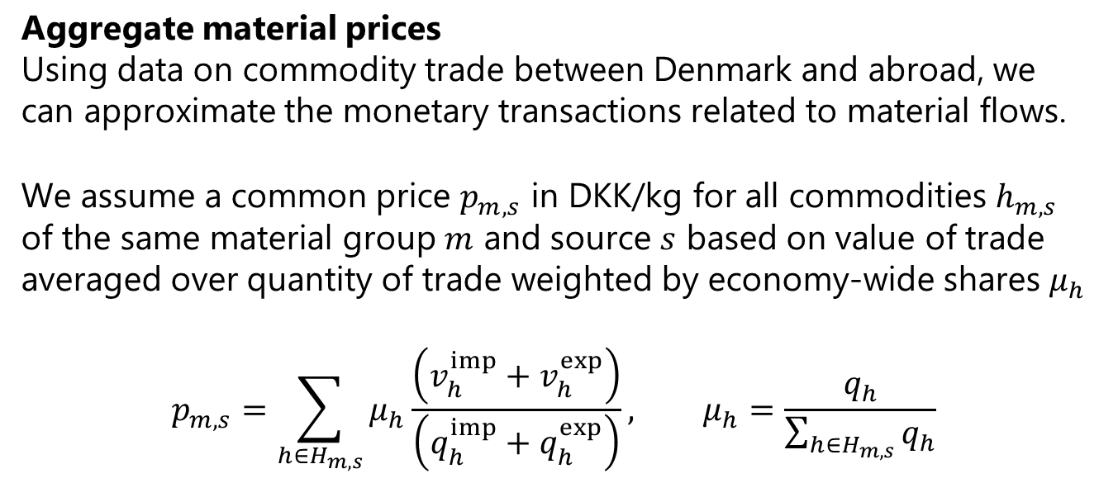
Appendix - Data
Aggregate material prices
Using data on commodity trade between Denmark and abroad, we can approximate the monetary transactions related to material flows.
We assume a common price $p_{m,s}$ in DKK/kg for all commodities $h_{m,s}$ of the same material group $m$ and source $s$ based on value of trade averaged over quantity of trade weighted by economy-wide shares $μ_{h}$
$$p_{m,s}=\sum_{h∈H_{m,s}}{μ_{h}\frac{\left(v_{h}^{imp}+v_{h}^{exp}\right)}{\left(q_{h}^{imp}+q_{h}^{exp}\right)}}, μ_{h}=\frac{q_{h}}{\sum_{h∈H_{m,s}}{q_{h}}}$$

Slide 82
Appendix - Data
Aggregate material prices
Using data on commodity trade between Denmark and abroad, we can approximate the monetary transactions related to material flows.
We assume a common price $p_{m,s}$ in DKK/kg for all commodities $h_{m,s}$ of the same material group $m$ and source $s$ based on value of trade averaged over quantity of trade weighted by economy-wide shares $μ_{h}$
$$p_{m,s}=\sum_{h∈H_{m,s}}{μ_{h}\frac{\left(v_{h}^{imp}+v_{h}^{exp}\right)}{\left(q_{h}^{imp}+q_{h}^{exp}\right)}}, μ_{h}=\frac{q_{h}}{\sum_{h∈H_{m,s}}{q_{h}}}$$
DKK/kg | Metal | Paper | Plastic | Rubber | Textile
Virgin (V) | 4.78 | 4.47 | 13.11 | 29.23 | 19.39
Recycled (R) | 2.88 | 0.63 | 1.96 | 1.03 | 3.29
Waste (W) | 0 | 0 | 0 | 0 | 0

